Slide 1
Intrusion Detection and Prevention Systems
Introduction to IDPS
Dr. P. Raghu Vamsi, JIIT University, Noida

Slide 2
Intrusion Detection and Prevention Systems
Also a you may view the lecture videos via my YouTube Channel at
https://www.youtube.com/channel/UC0oJO4o-UeMt5irLm6kxIWA
Dr. P. Raghu Vamsi, JIIT University, Noida

Slide 3
Goals of an IDPS
Network intrusion
Attempt to gain unauthorized access to network resources
Intrusion Detection and Prevention System (IDPS)
Consists of more than one application or hardware device
Incorporates more than just detection
Intrusion detection and prevention
Involves prevention, detection, and response

Slide 4
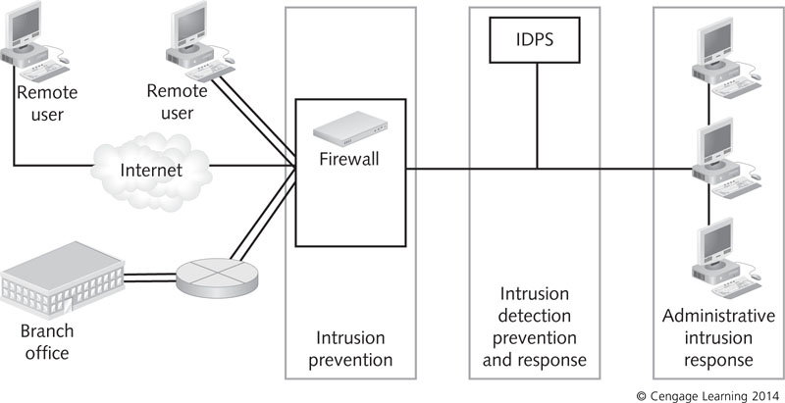
Figure 1 The role of intrusion detection and prevention in network defense

Slide 5
Goals of an IDPS
An IDPS should be able to:
Assess large volumes of network traffic or system activity to find signs of unauthorized access
Record its findings in a log so that administrators can examine past activity
Detect and record unauthorized access without compromise to produce evidence admissible in court
Respond almost immediately
Make itself and systems it protects as inaccessible as possible to attackers

Slide 6
Anomaly and Signature Detection Systems
Anomaly detection system: makes use of profiles that describe services and resources each authorized user normally accesses
Network baselines are associated with profiles
System can monitor profiles for suspicious activity that does not fit the profiles
IDPS can create baselines by monitoring network traffic to observe what is considered normal behavior

Slide 7
Anomaly and Signature Detection Systems
If profiles are incomplete or inaccurate:
IDPS sends alarms that false positives (legitimate traffic rather than actual attacks)
False negatives (genuine attacks that an IDPS does not detect) could occur
True negatives: legitimate communications that do not set off an alarm
True positive: used to describe a genuine attack that an IDPS detects successfully

Slide 8
Anomaly and Signature Detection Systems
Signature detection: triggers alarms based on characteristic signatures of known external attacks
Signature-based IDPS best for companies that want a basic IDPS and mostly concerned with known attacks
Network engineers research well-known attacks and record rules associated with each signature
Signatures should be updated regularly

Slide 9
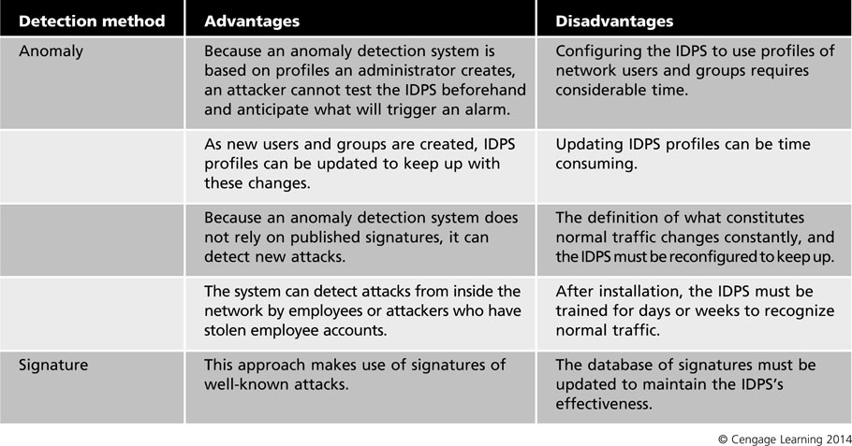
Table 1 Advantages and disadvantages of detection systems

Slide 10
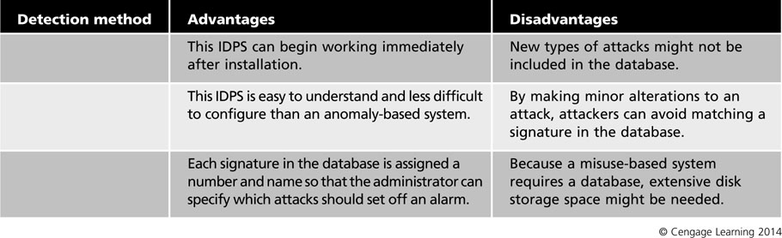
Table 1 Advantages and disadvantages of detection systems (continued)

Slide 11
Stateful Protocol Analysis
Stateful protocol analysis: information gathering about a connection
When an IDPS receives a packet, connection information between the host and remote computer is compared to entries in a state table
State table: maintains a record of connections between computers
Includes: source and destination IP address and port, and protocol
Event horizon: entire length of the attack
IDPS needs to maintain state information during this

Slide 12
Stateful Protocol Analysis
Stateful protocol analysis approaches:
Traffic rate monitoring – If IDPS detects sudden increase in traffic it can stop and reset all TCP traffic
Protocol state tracking – IDPS maintains a record of connection’s state and allows packets to pass through if it is an established connection
Dynamic Application layer protocol analysis – Can identify applications not using standard ports
IP packet reassembly – Can reassemble fragmented packets to prevent fragments from passing through to the internal network

Slide 13
Examining IDPS Components
Components
Network sensors or host-based agents
Detection and prevention capabilities
Command console
Database server that stores attack signatures or behaviors

Slide 14
Sensors and Agents
Sensor or agent
Functions as electronic “eyes” of an IDPS
Host-based IDPS – IDPS installed on a single host computer has its agent built into the IDPS software
Network-based IDPS – sensor is hardware or software that monitors network traffic in real time
Attacks detected by an IDPS sensor
Single-session attacks – isolated attempt
Multiple-session attacks – take place over a period of time

Slide 15
Sensors and Agents
Sensors should be placed at common-entry points
Internet gateways
Connections between one network and another
Remote access server that receives dial-up connections from remote users
Virtual private network (VPN) devices
Sensors could be positioned at either side of the firewall
Behind the firewall is a more secure location
IDPS management server: central repository for sensor and agent data

Slide 16
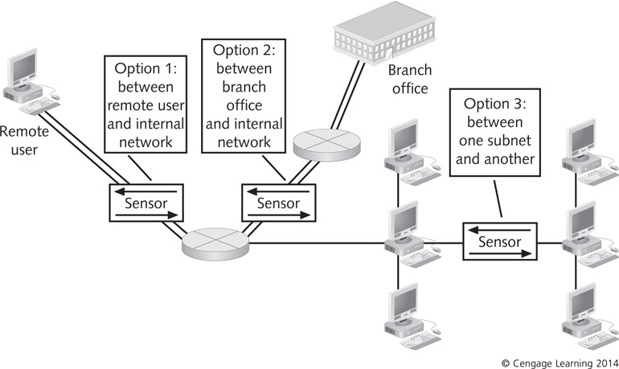
Figure 2 Positioning sensors at entry points to the network

Slide 17
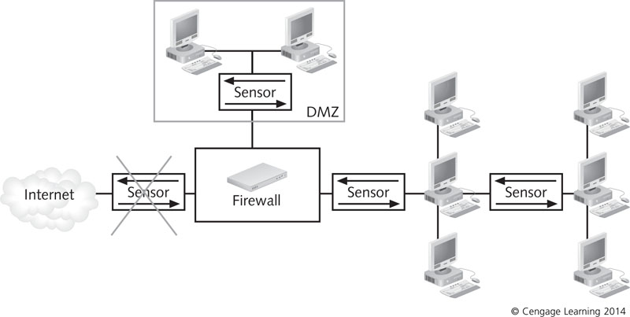
Figure 3 Positioning sensors behind the firewall in the DMZ

Slide 18
Detection and Prevention Capabilities
When selecting an IDPS, consider the following:
Threshold – Values that set the limit between normal and abnormal behavior
Blacklists – lists of entities that have been associated with malicious activity
Whitelists – lists of entities known to be harmless
Alert settings – specifying default priorities or severity levels, determining which prevention capabilities should be used for certain events, and specifying what information should be logged

Slide 19
Detection and Prevention Capabilities
Prevention Capabilities
IDPS can be configured to take preventative countermeasures
Example: resetting all network connections when an intrusion is detected
Some IDPSs allow administrators to specify which measure should be taken for each alert type
Some have a simulation mode in which all prevention capabilities are disabled but generate reports used to fine-tune prevention capabilities

Slide 20
Command Console
Provides a graphical front-end interface to an IDPS
Enables administrators to receive and analyze alert messages and manage log files
IDPS can collect information from security devices throughout a network
Command console should run on a computer dedicated solely to the IDPS
To maximize the speed of response

Slide 21
Database of Attack Signatures or Behaviors
IDPSs do not have the capability to use judgment
Can make use of a source of information for comparing the traffic they monitor
Signature-detection IDPS
Reference a database of known attack signatures
If traffic matches a signature, it sends an alert
Keep database updated
Anomaly-based IDPS
Store information about users in a database

Slide 22
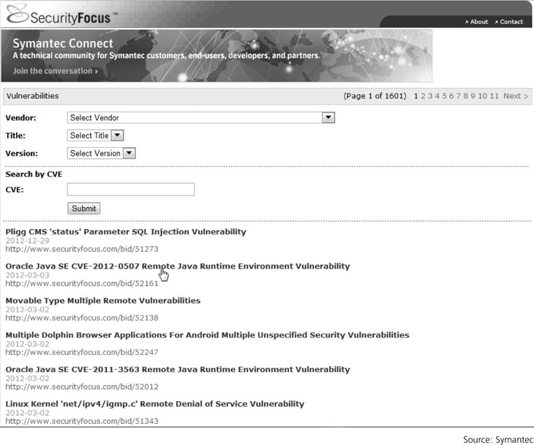
Figure 4 The SecurityFocus online database of known vulnerabilities

Slide 23
Options for IDPSs
Network-based IDPS
Host-based IDPS
Hybrid IDPS

Slide 24
Network-Based IDPSs
Network-based IDPS (NIDPS)
Monitors network traffic by using well-positioned sensors, management servers, a command console, and a signature database
Can be hardware devices equipped with NICs for capturing and analyzing packets
Can also be software-based sensors installed on a dedicated computer
Positioning an NIDPS on the Network
Behind the firewall and before the LAN
Between the firewall and the DMZ
Any network segment

Slide 25
Network-Based IDPSs
An NIDPS can use:
Inline sensors – positioned so that network traffic must pass through it
Used to stop attacks from blocking network traffic
Usually placed where firewalls are positioned
Passive sensors – monitor copies of traffic; no actual traffic passes through them
Can monitor traffic by:
Spanning port
Network tap
IDPS load balancer

Slide 26
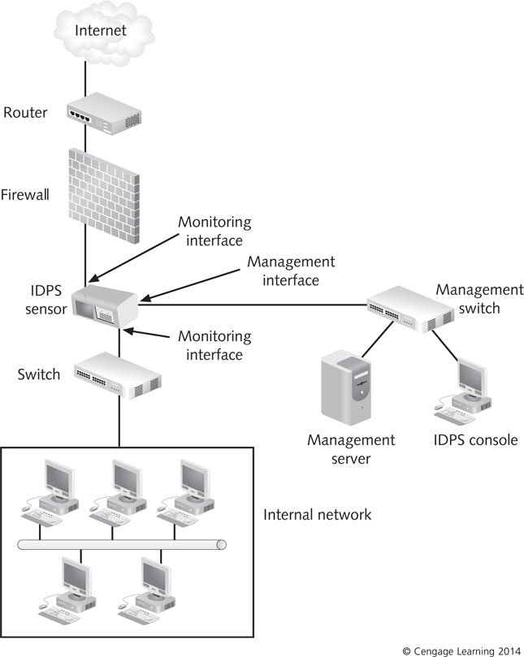
Figure 6 Positioning an inline sensor

Slide 27
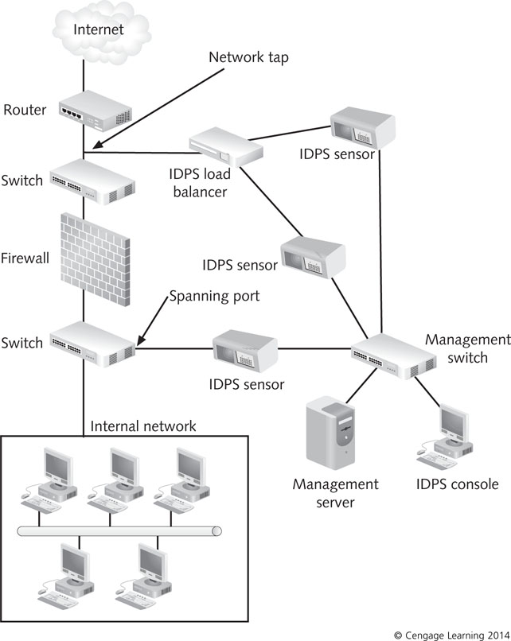
Figure 7 Positioning a passive sensor

Slide 28
Network-Based IDPSs
NIDPS Capabilities
Vary depending on product
Some can:
Collect information about hosts, OSs, applications, and network activities and characteristics
Used to help identify vulnerable hosts
Analyze packet headers to identify unusual behavior
Most have traffic logs to help identify and analyze potential attacks, locate vulnerabilities, and assess network use and performance

Slide 29
Network-Based IDPSs
NIDPS prevention capabilities vary based on sensor types:
Passive only – Ends the current TCP session
Inline only – Uses inline firewalling and bandwidth throttling, and alters malicious content
Passive and inline – Reconfigures other network security devices
Administrators can configure specific actions for each type of alert

Slide 30
Network-Based IDPSs
NIDPS Management
Designing architecture includes:
Determining where sensors are located
How many are needed and how they should be connected
Testing NIDPS components includes:
Accounting for network downtime while deploying sensors
Securing components involves:
Making sure sensors do not have IP addresses
Hardening management networks and configuring hosts for log files and backups

Slide 31
Host-Based IDPSs
Host-based IDPS (HIDPS)
Deployed on hosts in the network perimeter
Commonly use management servers, signature databases, and console
Evaluates traffic generated by the host
Often used to protect a Web server or database server
Gathers system variables such as
System processes, CPU use, file accesses, system logs, and system and application configuration changes
Does not sniff packets as they enter the LAN
Monitors log file entries and user activity

Slide 32
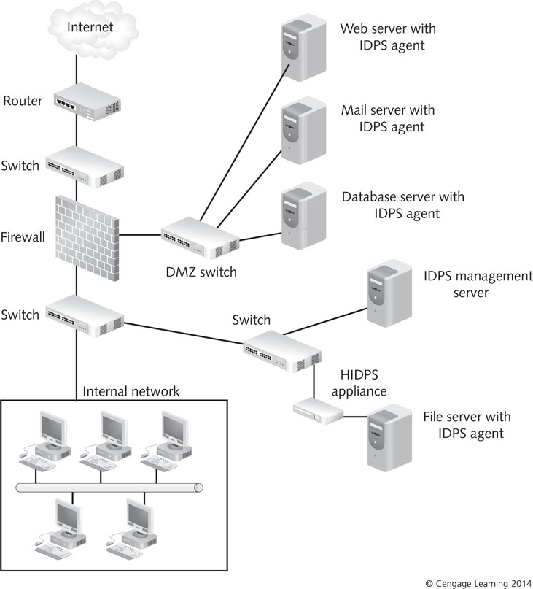
Figure 8 A typical HIDPS deployment

Slide 33
Host-Based IDPSs
Configuring an HIDPS
Centralized configuration
HIDPS sends all data to a central location
Host’s level of performance is unaffected by the IDPS
Alert messages that are generated do not occur in real time
Distributed configuration
Processing of events is distributed between host and console
Host generates and analyzes it in real time
Performance reduction in host

Slide 34
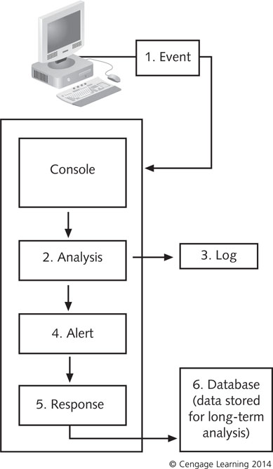
Figure 9 A centralized HIDPS

Slide 35
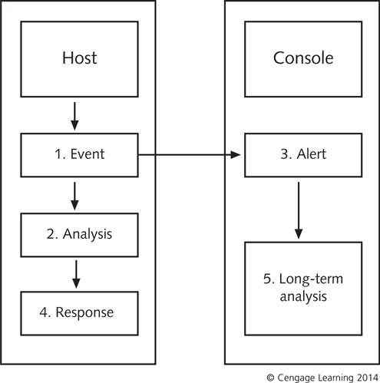
Figure 10 Processing event data from an HIDPS

Slide 36
Host-Based IDPSs
Choosing the Host
Centralized configuration
RAM, hard disk memory, and processor speed requirements are minimal
Distributed configuration
Host should be equipped with maximum memory and processor speed

Slide 37
Comparing an NIDPS and HIDPS
HIDPS
Can tell whether an attack attempt was successful
Can detect attacks that would get past NIDPS
Provides only data pertaining to the host, not network as a whole
Compares records stored in audit logs
NIDPS
Provides alerts on suspicious network activity
Does not tell whether attack occurred
Detects attacks on network
Such as port scanning on a range of computers

Slide 38
Hybrid IDPSs
Hybrid IDPS
Combines the features of HIDPSs and NIDPSs
Gains flexibility and increases security
Combining IDPS Sensor Locations
Put sensors on network segments and network hosts
Can report attacks aimed at particular segments or the entire network

Slide 39
Hybrid IDPSs
Combining IDPS Detection Methods
IDPS combines anomaly and signature detection
Database of known attack signatures enables IDPS to run immediately
Anomaly-based systems keep the alert system flexible
A hybrid IDPS that combines anomaly and signature detection can respond to both external and internal attacks
Administrators have more configuration and coordination work to do

Slide 40
Hybrid IDPSs
Advantages
Combine aspects of NIDPS and HIDPS configurations
Can monitor network as a whole
Can monitor attacks that reach individual hosts
Disadvantages
Getting disparate systems to work in coordinate fashion
Data gathered by multiple systems can be difficult to analyze

Slide 41
Securing IDPS Components
IDPS must be able to handle the volume of traffic or activity it encounters
IDPSs should be tested regularly
Sensors should not be addressable
Communication between IDPS components should be encrypted
Authentication should be required for use and administration of the IDPS
IDPSs should be able to work during DoS attacks
Remote logging should be used in an HIDPS
OSs of HIDPSs should be patched and hardened

Slide 42
Developing IDPS Filter Rules
To create IDPS filter rules you must know basics of Snort rule syntax
Snort rule has two sections: header and options
Example:
Alert tcp any any -> 192.16.21.0/24 111 (content: “00 01 86 a5” ; msg: “mounted access”;)
Header is the opening portion
Options are in parentheses

Slide 43
Examining Intrusion Detection Step by Step
Steps
Installing the IDPS database
Gathering data
Sending alert messages
The IDPS responds
The administrator assesses damage
Following escalation procedures
Logging and reviewing events

Slide 44
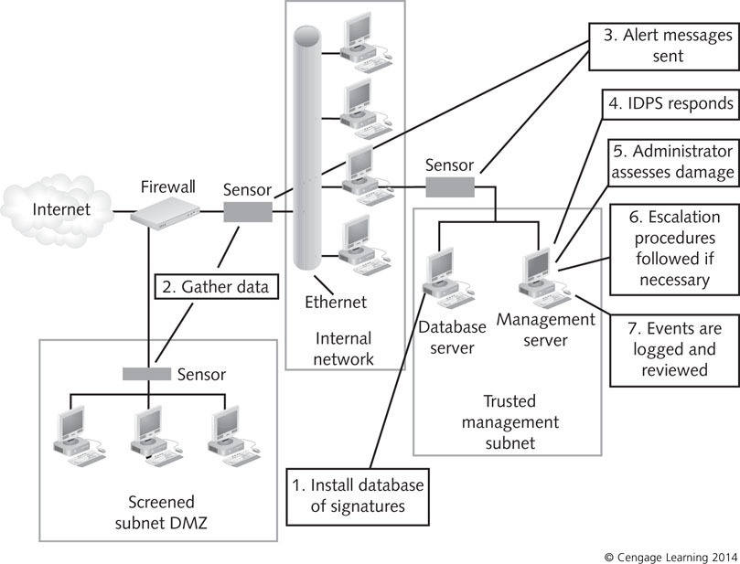
Figure 11 Steps in intrusion detection

Slide 45
Step 1: Installing the IDPS Database
IDPS uses the database to compare traffic detected by sensors
Anomaly-based systems
Requires compiling a network baseline by observing network traffic (over a week)
Signature-based IDPS
Can use database immediately
You can add your own custom rule base

Slide 46
Step 2: Gathering Data
Network sensors gather data by reading packets
Sensors need to be positioned where they can capture all packets
Sensors on individual hosts capture information that enters and leaves the host
Sensors on network segments read packets as they pass throughout the segment
Sensors on network segments cannot capture all packets
If traffic levels become too heavy

Slide 47
Step 3: Sending Alert Messages
IDPS detection software compares captured packets with information in its database
IDPS sends alert messages
If captured packets match an attack signature or
Deviates from normal network behavior

Slide 48
Step 4: The IDPS Responds
Command console receives alert messages
Notifies the administrator
IDPS response actions:
Alarm - Send an alarm message
Drop – Packet is dropped
Reset – IDPS stops and restarts network traffic
Code analysis – Prevents malicious code from running
File system monitoring – Prevent files from being modified
Network traffic filtering – act as firewall
Network traffic analysis – stop incoming traffic

Slide 49
Step 5: The Administrator Assesses Damage
Administrator monitors alerts
Determines whether countermeasures are needed
Administrator need to fine-tune the database
The goal is avoiding false negatives
Line between acceptable and unacceptable network use is not always clear

Slide 50
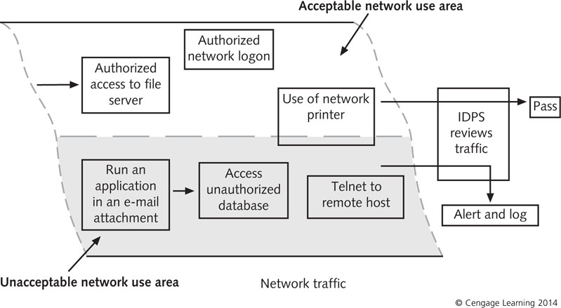
Figure 12 Differentiating acceptable and unacceptable network use

Slide 51
Step 6: Following Escalation Procedures
Escalation procedures
Set of actions to be followed if the IDPS detects a true positive
Should be spelled out in company’s security policy
Incident levels
Level One
Might be managed quickly
Level Two
Represents a more serious threat
Level Three
Represents the highest degree of threat

Slide 52
Step 7: Logging and Reviewing the Event
IDPS events are stored in log files
May also be sent to a database file
Administrator should review logs
To determine patterns of misuse
Administrator can spot a gradual attack
IDPS should also provide accountability
Ability to track an attempted attack or intrusion back to the responsible party
Some systems have built-in tracing features

Slide 53
Evaluating IDPS Products
Evaluate the various options and match them to your needs
Consider the following basic factors:
Determine whether an IDPS is necessary
Conduct a risk assessment
Define general requirements and goals an IDPS should meet
Determine whether to use proprietary or open-source products
Consider the frequency and accuracy of signature updates
Assess availability of support

Slide 54
Evaluating IDPS Products
Consider the following basic factors (cont’d):
Evaluate technical specifications
Determine external security requirements
Evaluate need for security capabilities and logging
Review detection and prevention capabilities
Identify performance and management requirements
Define the interoperability and scalability
Determine a reasonable cost estimate that includes acquisition, testing, installation, and maintenance
Identify resource limitations
Identify any training, documentation, and support needed

Slide 55
Summary
Intrusion detection and prevention systems (IDPSs) add another line of defense behind firewalls and antivirus software
IDPS components include sensors, management servers, command consoles, and databases of signatures
A network-based IDPS (NIDPS) uses sensors positioned at key points on the network
A host-based IDPS (HIDPS) deploys agents on selected hosts in the network

Slide 56
Summary
A hybrid IDPS combines aspects of NIDPS and HIDPS configurations
Selecting an IDPS requires evaluating the organization’s needs and security goals and the product’s features
Steps of intrusion detection include: installing the IDPS and signature database, gathering data, sending an alert, responding to the alert, assessing damage, following escalation procedures, and logging and reviewing events

Slide 57
References
J. Paul Guyer, P.E., R.A, "An Introduction to Intrusion Detection Systems", The Clubhouse Press, California, 2018.
Weaver, Randy, Dawn Weaver, and Dean Farwood. Guide to network defense and countermeasures. Cengage Learning, 2013.
G. Dileep Kumar, "Network Security Attacks and Countermeasures", IGI Global, 2016.
Nagendra Kumar Nainar, Yogesh Ramdoss, and Yoram Orzach, "Network Analysis Using Wireshark 2 Cookbook: Practical recipes to analyze and secure your network using Wireshark 2, 2nd Edition, Packt, 2018.
Andrei Miroshnikov, "Windows Security Monitoring: Scenarios and Patterns", Wiley, 2018.
Steve Suehring, "Linux Firewalls: Enhancing Security with nftables and Beyond", Addison-Wesley, 2015.
Easttom II, William Chuck. Network defense and countermeasures: principles and practices. Pearson IT Certification, 2013.
Snort 3.0 User manual, httpw://www.snort.org
Internet security http://www.cis.syr.edu/~wedu/Teaching/cis758/readings.html
Open Learn https://www.open.edu/openlearn/ocw/mod/oucontent/view.php?id=48261
IDPS https://cloudacademy.com/course/intrusion-detection-and-prevention-on-amazon-web-services/ids-ips-in-detail-1/
SVNIT course structure http://www.svnit.ac.in/web/department/computer/CO624.php
Detecting and Mitigating Cyber Threats and Attacks https://www.coursera.org/learn/detecting-cyber-attacks/home/welcome
Secure Networked System with Firewall and IDS https://www.coursera.org/learn/secure-networked-system-with-firewall-ids/home/welcome
https://www.coursera.org/learn/secure-networked-system-with-firewall-ids#syllabus
Customizable Network intrusion dataset creator https://github.com/nrajasin/Network-intrusion-dataset-creator
https://www.researchgate.net/post/Is_there_any_tool_to_convert_pcap_tcpdump_file_into_KDD_dataset_format
Information Security and Assurance https://people.eecs.ku.edu/~saiedian/710/
http://ranger.uta.edu/~dliu/courses/cse6392-ids-spring2007/
SNORT Tutorial https://www.youtube.com/watch?v=W1pb9DFCXLw&list=PLpPXZRVU-dX33VNUeqWrMmBNf5FeKVmi-

